Slide 1
Chapter 20
Measuring Economic Activity

Slide 2
Gross domestic product: The yardstick of an economy’s performance
GDP:C+I+G+X
Two measures of national product
Goods flow and Earnings flow
  Flow-of-product Approach
  Earnings or Income Approach
  Equivalence of the two approach

Slide 3
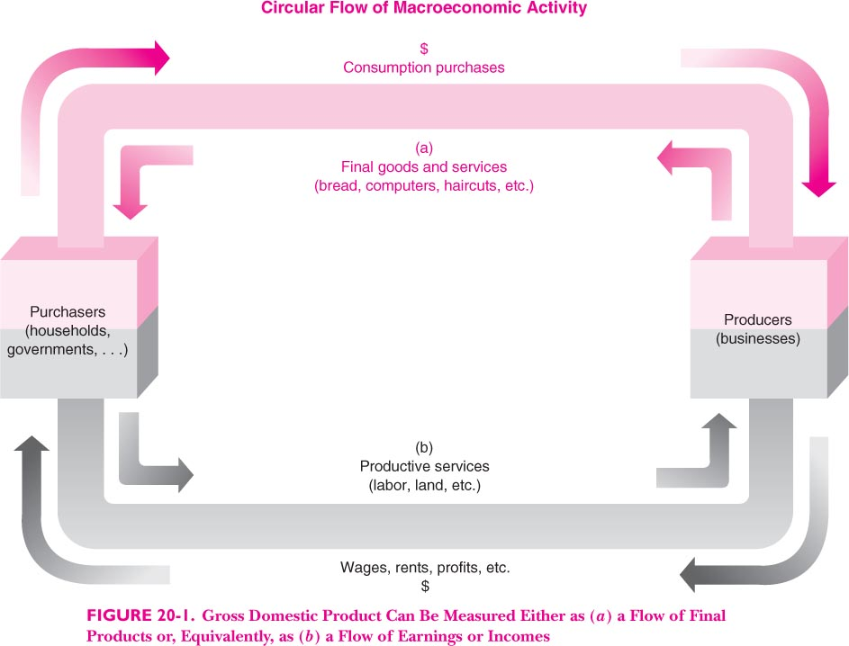

Slide 4
National accounts derived from business accounts

Slide 5
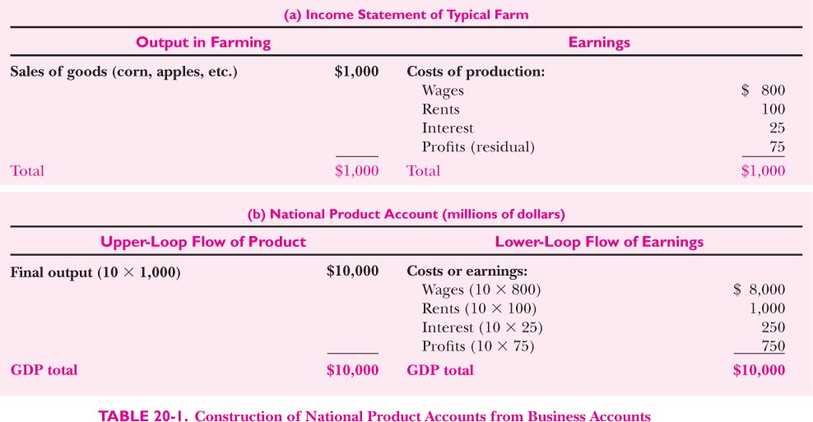

Slide 6
The problems of “Double Counting”
  “Value Added” in the lower loop

Slide 7
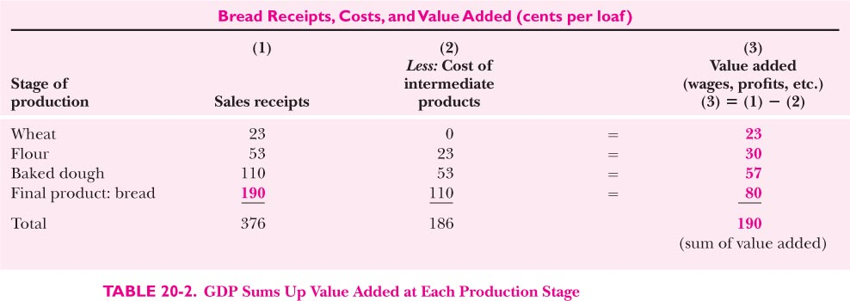

Slide 8
Details of the national accounts
Real vs. Nominal GDP: “Deflating” GDP by price index
Further details on chain weights
  WHY AND HOW?

Slide 9
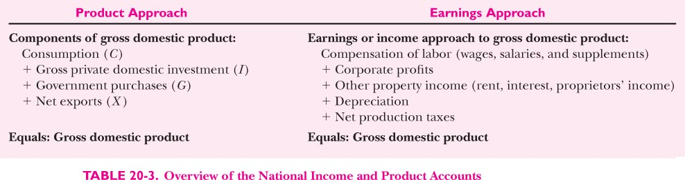

Slide 10
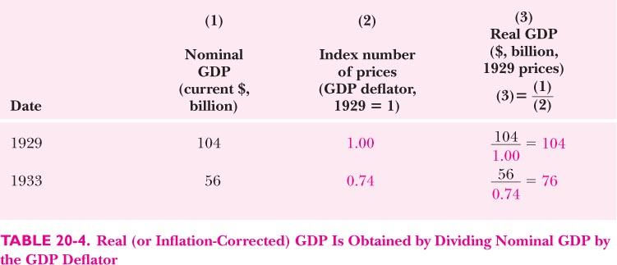

Slide 11
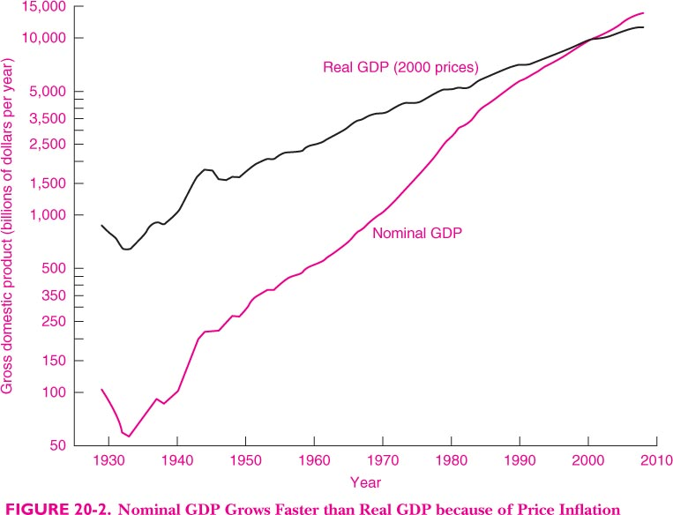

Slide 12
跨期比较：真实GDP与名义GDP
60年的积蓄，我们的国内生产总值实际增长77倍，人均超过3000美元；财政收入增长约1000倍；外汇储备增长1万多倍，位居世界第一；
“我要代表农民铸鼎刻铭，告知后人，万代歌颂永世不忘。”2006年1月1日，国家取消农业税，河北农民王三妮铸成“告别田赋鼎”。
“一个有着明确发展目标并致力于实现这些目标的政府，一个能够激励生产力和调动积极性的经济体制，加上人民的勤奋努力，是中国成功发展的基本经验。”联合国负责经济与社会事务的副秘书长沙祖康一语中的。
What a journalist!!!
2008年30万亿GDP，1952年大约4000亿（问题是1952年是这么多吗）。77倍；
30万亿/13亿/7块每美元=3000多点

Slide 13
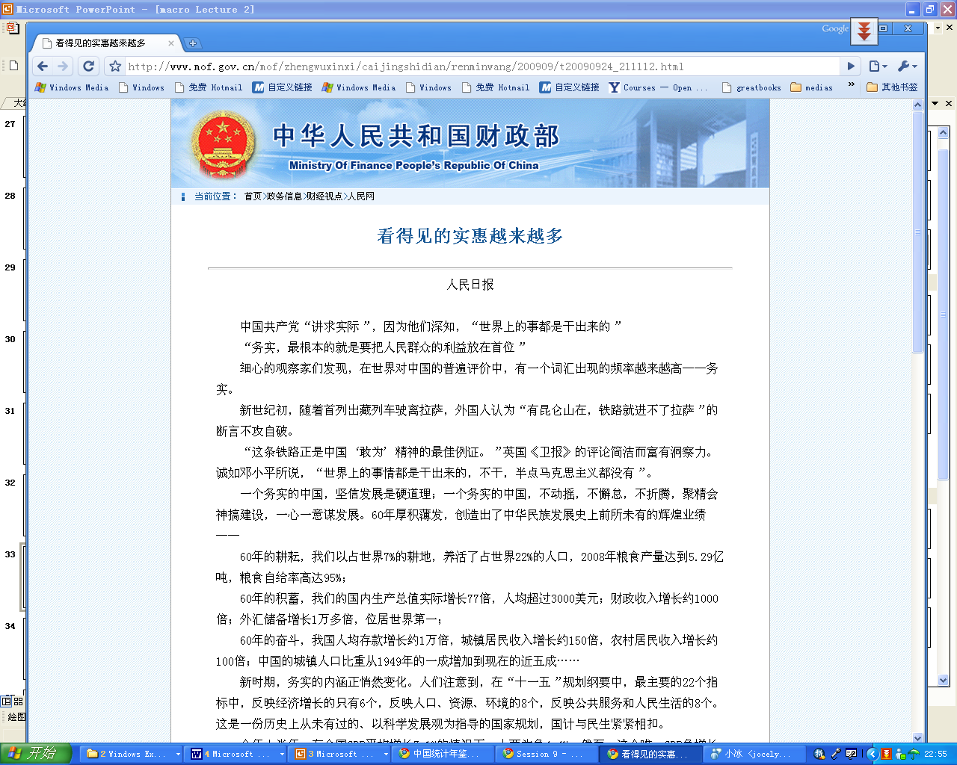
跨期的生活水平比较：真实GDP

Slide 14
真实GDP与名义GDP
2008年GDP是300670亿元，1978年是3600亿，我们说增长了83倍。X.
举个例子
  2000年 2007年
  一斤酱肘子 10元*1=10 15×2=30
  一次洗澡 20元×2=40 18×2=36
  ——————————————————————
  名义GDP 50 66
  真实GDP 50 60
  GDP缩减指数 名义GDP/真实GDP
  GDP指数 100 112?120

Slide 15
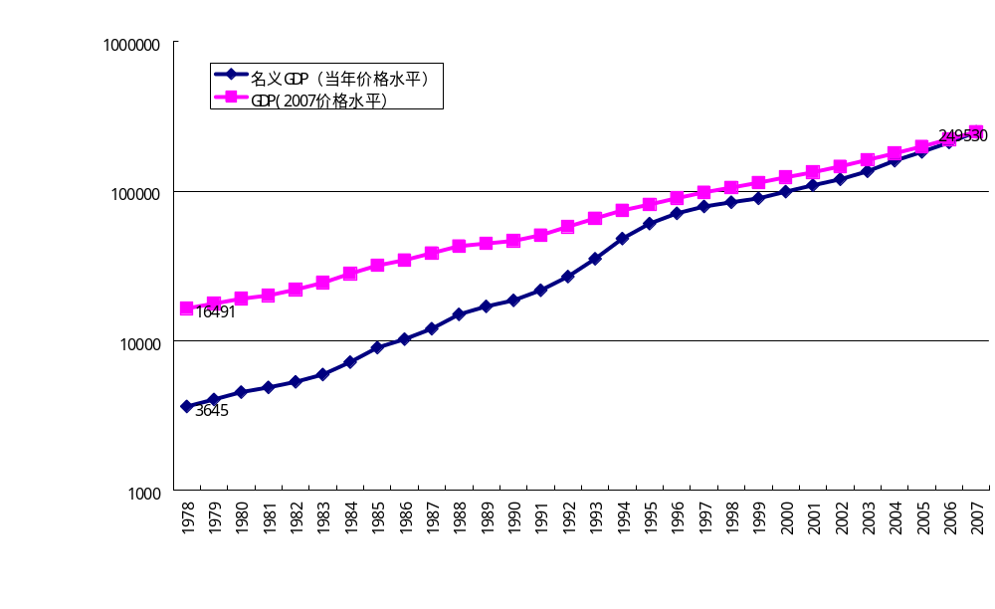
1978-2007:真实GDP和名义GDP

Slide 16
Consumption
Investment and capital formation
  Net vs. Gross investment
Government purchases
  Exclusion of transfer payments
  Taxes
Net Exports
Gross domestic products, net domestic products, and gross national product

Slide 17
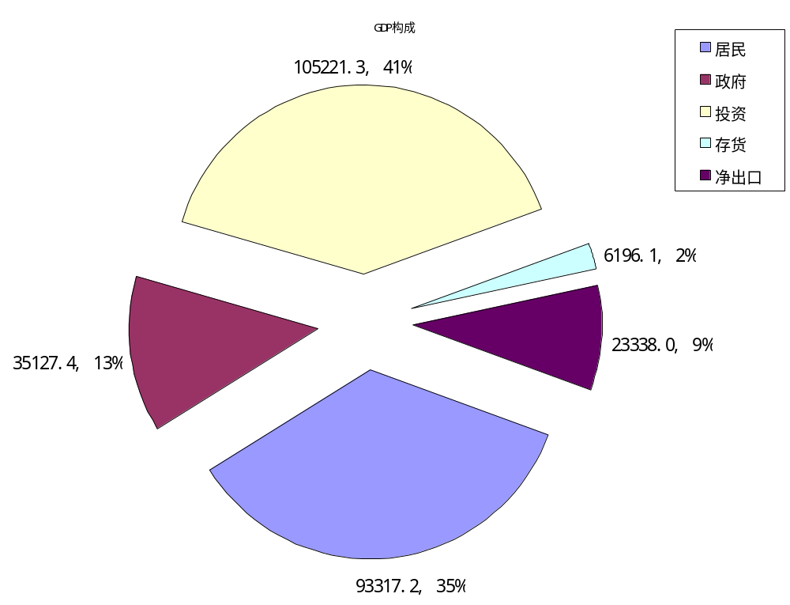
GDP支出构成

Slide 18
美国GDP的构成 (2001)
政府购买G
18%
净出口NX
-3 %
投资I
16%
消费C
69%

Slide 19
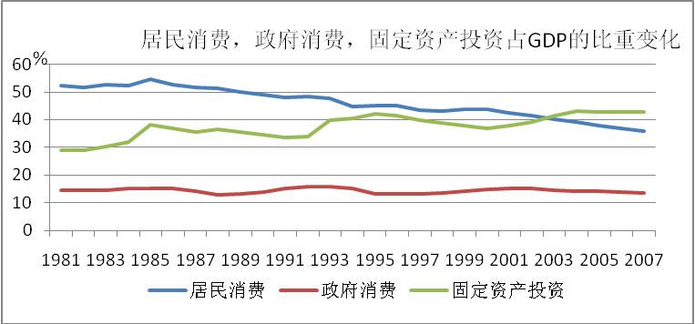

Slide 20
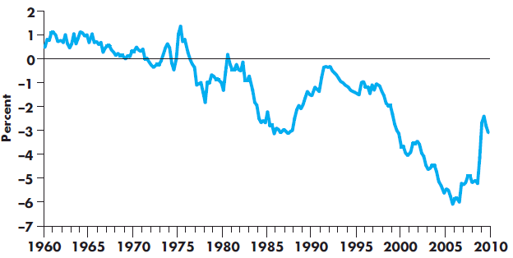

Slide 21
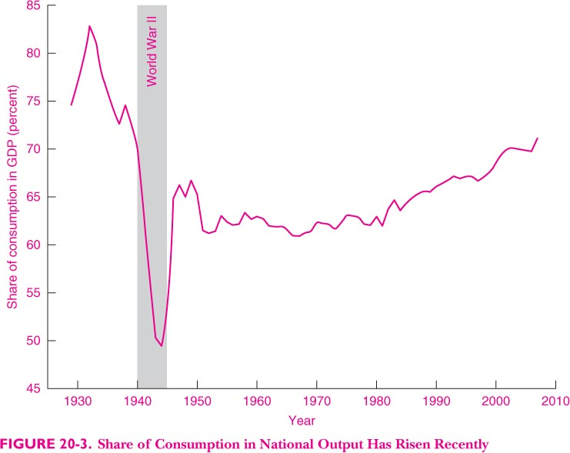

Slide 22
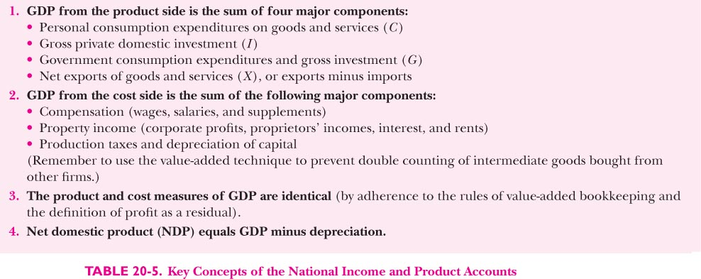

Slide 23
GDP and NDP： A look at numbers
  Flow-of-product approach
  Flow-of-cost approach

Slide 24
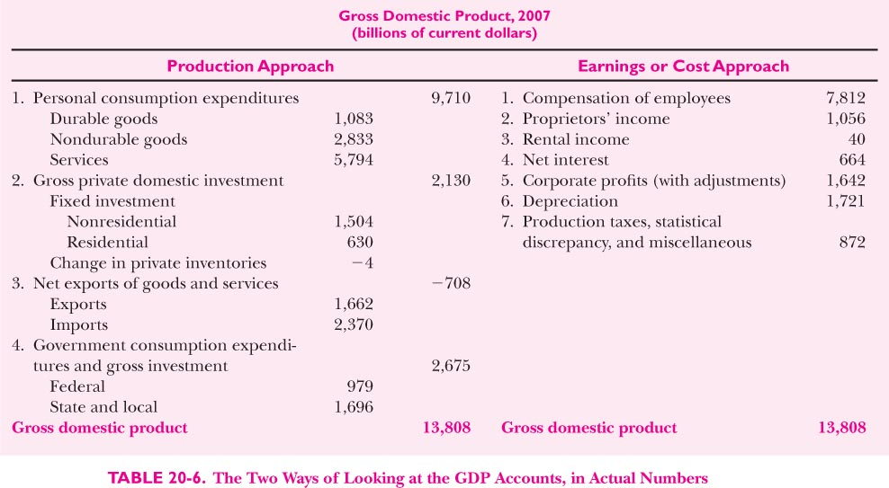

Slide 25
From GDP to disposable income
  National income
  Disposable income

Slide 26
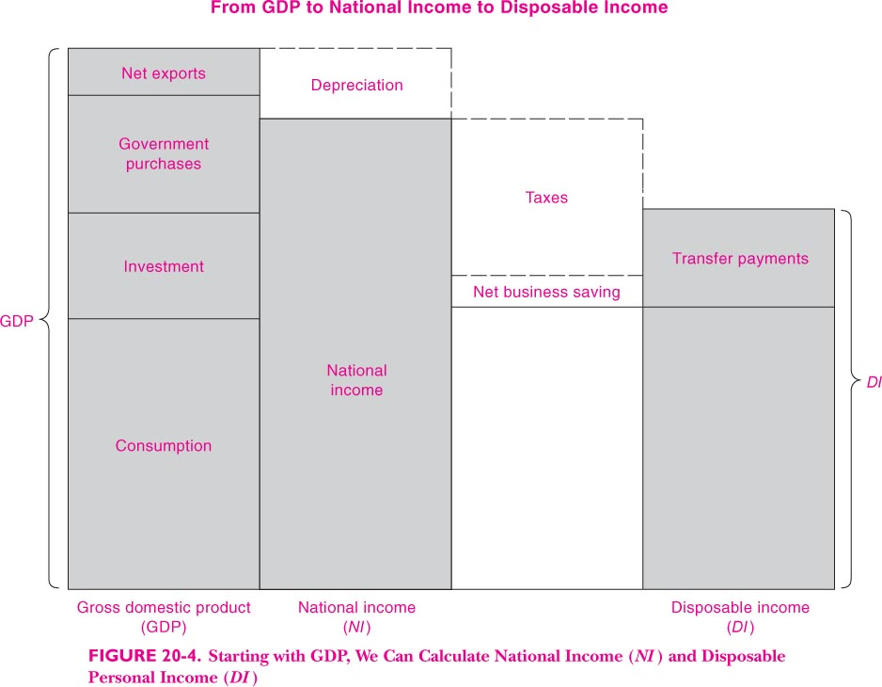

Slide 27
Saving and investment
  I: product approach GDP-C
  S: earning-approach GDP minus C
  I=S
  National investment=private investment+net export=
  Private saving +government saving=national saving

Slide 28
Beyond the national accounts
Ommitted nonmarket activities
  Human capital
  Household production
  Leisure time
  Underground economy
  Poet, romantics and love etc…
Omitted environmental damage

Slide 29
Omitted environmental damage
  Augmented national account

Slide 30
Price index and inflation
Price indexes
  The consumer price index(CPI)
  GDP price index
  The producer price index(PPI)
Accounting assessment

Slide 31
The Consumer Price Index
Consumer price index (CPI)
  Measure of the overall level of prices
  Measure of the overall cost of goods and services
    Bought by a typical consumer
  Bureau of Labor Statistics
© 2015 Cengage Learning. All Rights Reserved. May not be copied, scanned, or duplicated, in whole or in part, except for use as permitted in a li

Slide 32
Calculating CPI
Fix the basket
  Which prices are most important to the typical consumer
  Different weight
Find the prices
  At each point in time
Compute the basket’s cost
  Same basket of goods
  Isolate the effects of price changes
© 2015 Cengage Learning. All Rights Reserved. May not be copied, scanned, or duplicated, in whole or in part, except for use as permitted in a license distributed with a certain product or service or otherwise on a password-protected website for classroom use.

Slide 33
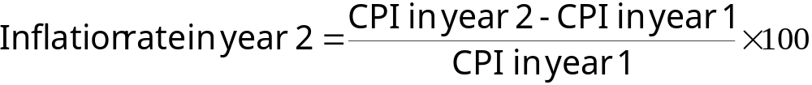
Calculating CPI
Chose a base year and compute the CPI
  Base year = benchmark
    Price of basket of goods and services in current year
    Divided by price of basket in base year
    Times 100
Compute the inflation rate
© 2015 Cengage Learning. All Rights Reserved. May not be copied, scanned, or duplicated, in whole or in part, except for use as permitted in a license distributed with a certain product or service or otherwise on a password-protected website for classroom use.

Slide 34
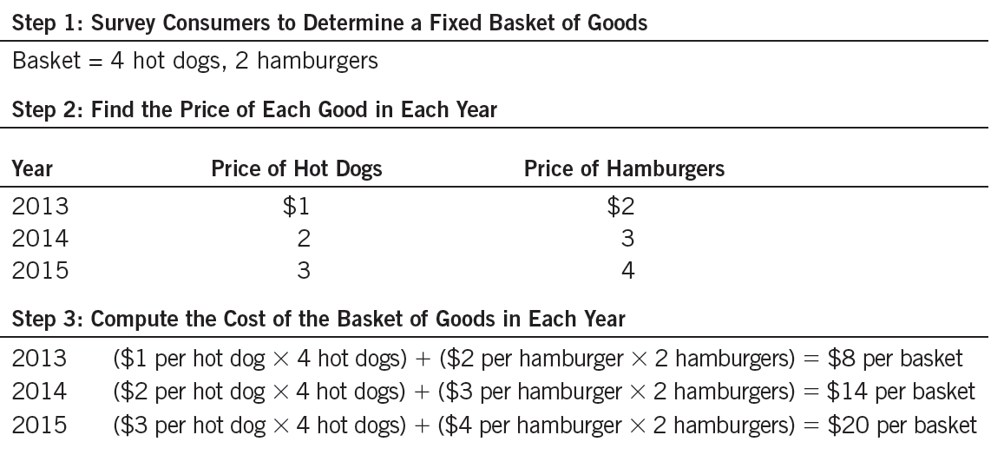
Table 1
Calculating the Consumer Price Index and the Inflation Rate: An Example
This table shows how to calculate the consumer price index and the inflation rate for a hypothetical economy in which consumers buy only hot dogs and hamburgers.
© 2015 Cengage Learning. All Rights Reserved. May not be copied, scanned, or duplicated, in whole or in part, except for use as permitted in a license distributed with a certain product or service or otherwise on a password-protected website for classroom use.

Slide 35
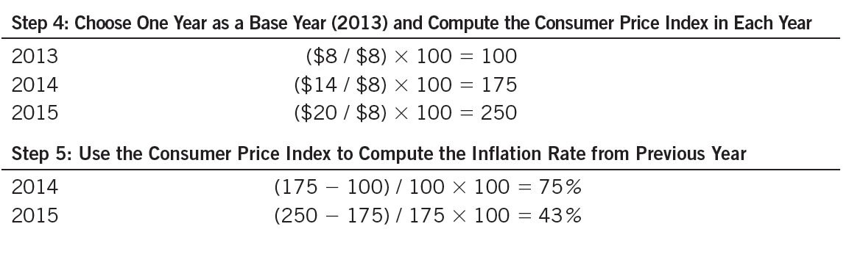
Table 1
Calculating the Consumer Price Index and the Inflation Rate: An Example
This table shows how to calculate the consumer price index and the inflation rate for a hypothetical economy in which consumers buy only hot dogs and hamburgers.
© 2015 Cengage Learning. All Rights Reserved. May not be copied, scanned, or duplicated, in whole or in part, except for use as permitted in a license distributed with a certain product or service or otherwise on a password-protected website for classroom use.

Slide 36
The Consumer Price Index
Inflation rate
  Percentage change in the price index
    From the preceding period
Producer price index, PPI
  Measure of the cost of a basket of goods and services bought by firms
  Changes in PPI are often thought to be useful in predicting changes in CPI
© 2015 Cengage Learning. All Rights Reserved. May not be copied, scanned, or duplicated, in whole or in part, except for use as permitted in a license distributed with a certain product or service or otherwise on a password-protected website for classroom use.

Slide 37
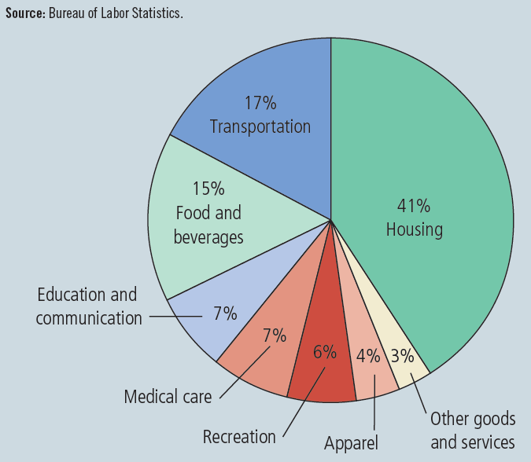
Figure 1
The Typical Basket of Goods and Services
This figure shows how the typical consumer divides spending among various categories of goods and services. The Bureau of Labor Statistics calls each percentage the “relative importance” of the category.
© 2015 Cengage Learning. All Rights Reserved. May not be copied, scanned, or duplicated, in whole or in part, except for use as permitted in a license distributed with a certain product or service or otherwise on a password-protected website for classroom use.

Slide 38
The Consumer Price Index
Problems in measuring the cost of living
  Substitution bias
    Prices do not change proportionately
    Consumers substitute toward goods that have become relatively less expensive
  Introduction of new goods
    More variety of goods
  Unmeasured quality change
    Changes in quality
© 2015 Cengage Learning. All Rights Reserved. May not be copied, scanned, or duplicated, in whole or in part, except for use as permitted in a license distributed with a certain product or service or otherwise on a password-protected website for classroom use.

Slide 39
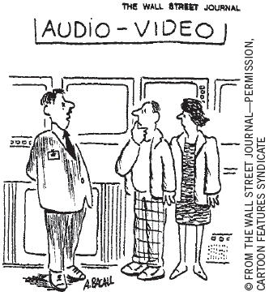
GDP deflator versus CPI
GDP deflator
  Ratio of nominal GDP to real GDP
  Reflects prices of all goods & services produced domestically
CPI
  Reflects prices of goods & services bought by consumers
“The price may seem a little high, but you have to remember that’s in today’s dollars.”
© 2015 Cengage Learning. All Rights Reserved. May not be copied, scanned, or duplicated, in whole or in part, except for use as permitted in a license distributed with a certain product or service or otherwise on a password-protected website for classroom use.

Slide 40
GDP deflator versus CPI
GDP deflator
  Compares the price of currently produced goods and services
    To the price of the same goods and services in the base year
CPI
  Compares price of a fixed basket of goods and services
    To the price of the basket in the base year
© 2015 Cengage Learning. All Rights Reserved. May not be copied, scanned, or duplicated, in whole or in part, except for use as permitted in a license distributed with a certain product or service or otherwise on a password-protected website for classroom use.

Slide 41
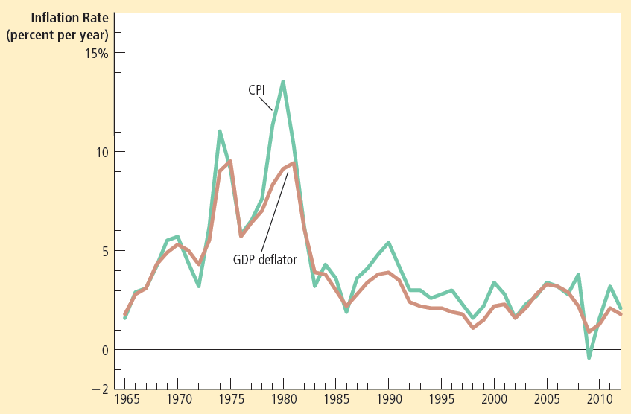
Figure 2
Two Measures of Inflation
This figure shows the inflation rate—the percentage change in the level of prices— as measured by the GDP deflator and the consumer price index using annual data since 1965. Notice that the two measures of inflation generally move together.
© 2015 Cengage Learning. All Rights Reserved. May not be copied, scanned, or duplicated, in whole or in part, except for use as permitted in a license distributed with a certain product or service or otherwise on a password-protected website for classroom use.

Slide 42
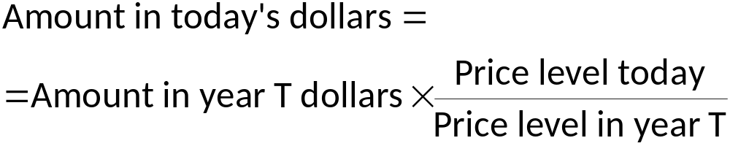
Correcting Economic Variables
Dollar figures from different times
Indexation
  Automatic correction by law or contract
  Of a dollar amount
  For the effects of inflation
  COLA: Cost of living allowance
© 2015 Cengage Learning. All Rights Reserved. May not be copied, scanned, or duplicated, in whole or in part, except for use as permitted in a license distributed with a certain product or service or otherwise on a password-protected website for classroom use.

Slide 43
Real and Nominal Interest Rates
Nominal interest rate
  Interest rate as usually reported
  Without a correction for the effects of inflation
Real interest rate
  Interest rate corrected for the effects of inflation
= Nominal interest rate – Inflation rate
© 2015 Cengage Learning. All Rights Reserved. May not be copied, scanned, or duplicated, in whole or in part, except for use as permitted in a license distributed with a certain product or service or otherwise on a password-protected website for classroom use.

Slide 44
Interest rates in the U.S. Economy
Nominal interest rate
  Always exceeds the real interest rate
  U.S. economy has experienced rising consumer prices in every year
Inflation is variable
  Real and nominal interest rates do not always move together
Periods of deflation
  Real interest rate exceeds the nominal interest rate
© 2015 Cengage Learning. All Rights Reserved. May not be copied, scanned, or duplicated, in whole or in part, except for use as permitted in a license distributed with a certain product or service or otherwise on a password-protected website for classroom use.

Slide 45
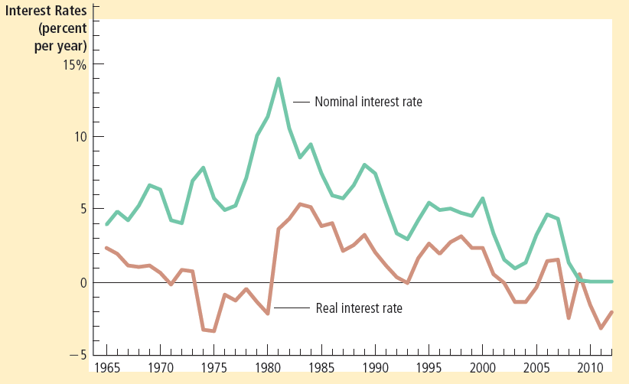
Figure 3
Real and Nominal Interest Rates
This figure shows nominal and real interest rates using annual data since 1965. The nominal interest rate is the rate on a 3-month Treasury bill. The real interest rate is the nominal interest rate minus the inflation rate as measured by the consumer price index. Notice that nominal and real interest rates often do not move together.
© 2015 Cengage Learning. All Rights Reserved. May not be copied, scanned, or duplicated, in whole or in part, except for use as permitted in a license distributed with a certain product or service or otherwise on a password-protected website for classroom use.

Slide 46
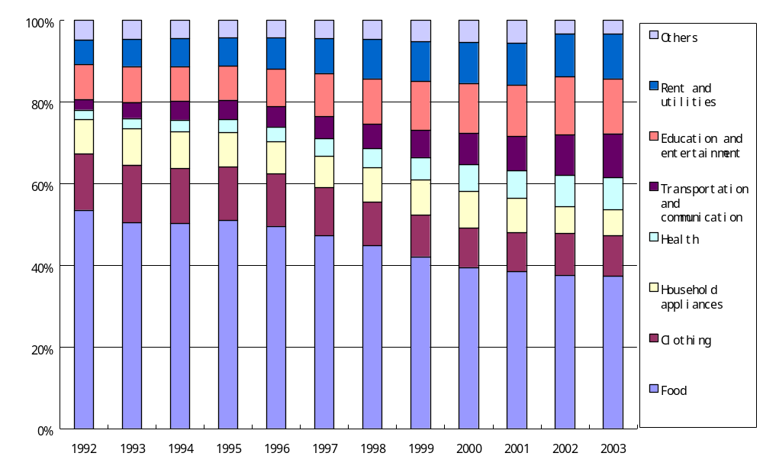
中国的CPI权重：食品占35%

Slide 47

美国的CPI权重
16%
食品
17%
41%
交通
房子
教育
6%
通讯
6%
6%
4%
4%
医疗
其他
娱乐
Apparel衣服
Copyright©2004 South-Western

Slide 48

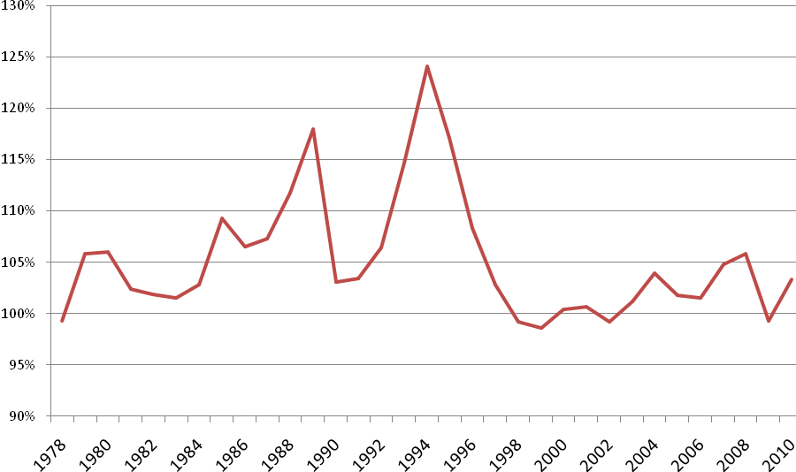
China’s CPI: 1978-2010

Slide 49
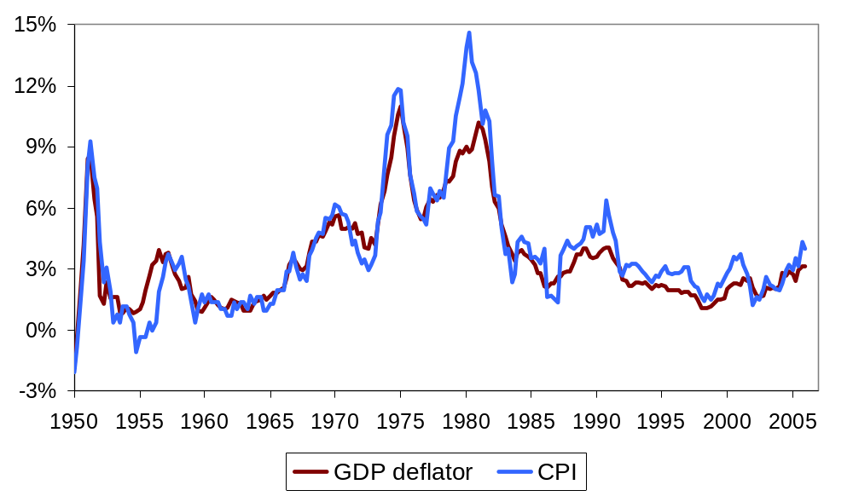
Two measures of inflation in the U.S.
Percentage change
from 12 months earlier
Notes:
source: http://research.stlouisfed.org/fred2/
In 1980, the CPI increased much faster than the GDP deflator. Ask students if they can offer a possible explanation. In 1955, the CPI showed slightly negative inflation, while the GDP deflator showed positive inflation. Ask students for possible explanations.
(For possible answers, just refer to previous slide.)

Slide 50

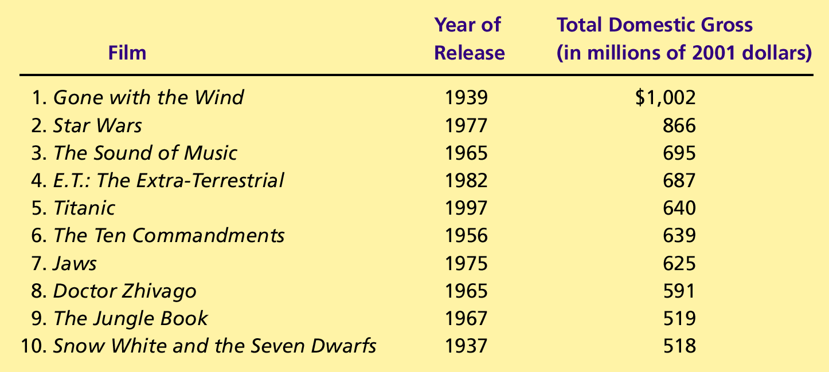
什么是最卖座影片？
Copyright©2004 South-Western

Slide 51
China’s CPI: 1978-2010

Slide 52
Homework
Q3
Q4
Q5
Q9

